Slide 1
Youth Leadership Games
Sports and fitness for the community

Slide 2
Agenda
Introductions
Leading2Play
Implementation with Pinole Valley High School’s Health Academy
Looking back and looking forward
Q & A

Slide 3
Outcomes
By the end of this session, you should be able to…
Plan how to involve your students in health leadership
experiences
Implement an alternative for mainstream sports culture
Learn how partnerships in the community can work

Slide 4
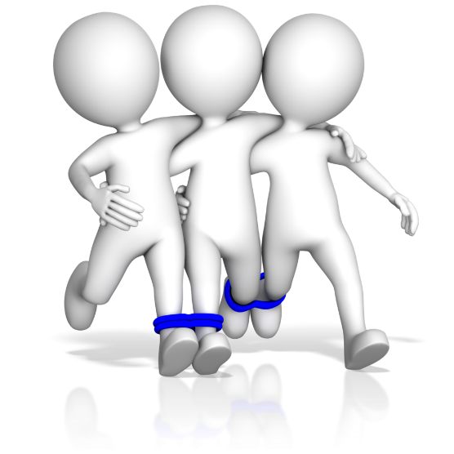
Introductions
Dan O’shea
Tiffany holliday
GEORGE SELLECK
Teacher
PLTW Principles of Biomedical Science
Kinesiology: Applied Anatomy & Physiology
Sports Medicine
Certified Athletic Trainer
Coach
Teacher
English, 10-12th grade
Health Academy Lead
Stanford BA/1956, MA/1957
USC Ph.D. Psychology 1972
Author
Founder of non-profits dedicated to improving sports experiences for youth
Pac-12 & Stanford Basketball Hall of Fame

Slide 5
Today’s generation of kids is the first in our history that is NOT projected to live longer than their parents.

Slide 6
Leading2play
The only organization in the country that puts kids in charge of designing and implementing fun and engaging sports and fitness activities open to all their peers regardless of ability.
This leads to:
An antidote to the 75% of kids who drop out of youth sports every year
An opportunity for schools whose physical education budget has been slashed
A way to combat childhood obesity by making fitness fun and habit forming
A chance for kids to learn leadership and organizational skills that will benefit them in school, work, and life!

Slide 7
Implementation – weekly lessons
Student buy-in
Weekly lessons and activities on Fridays
Students self-selected teams
Each team planned 3 activities, then selected one to implement
Full team consensus
No repeats of games

Slide 8
Implementation - Step 3
Facilities
Scheduling
Equipment
Costs
Other resources

Slide 9
Implementation – weekly lessons cont’d
Promoting the activities
Contacting neighborhood elementary schools
Business letter writing
Audience and purpose (tie to Common Core)
Face-to-face with principal
Final planning

Slide 10
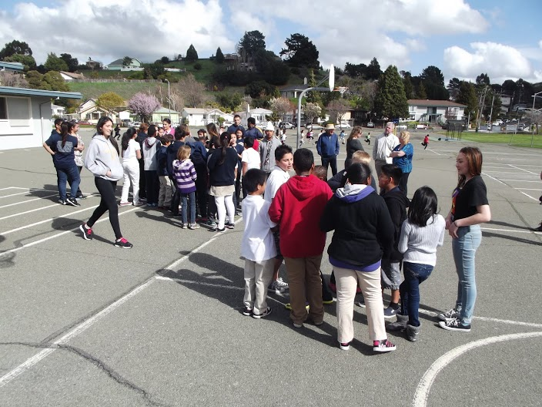
Implementation – the big event
Two sessions of about 1 hour each
About 50 4th and 5th graders in each session

Slide 11
Looking back
What worked
What we would change
Students (high school and elementary) had FUN!
Leadership skills developed and practiced with an authentic audience
Physical fitness awareness built
Relationship with elementary school established
Teachers learning to be “hands off” during the event
More aggressive in securing community partners to host event (so less down time)
Community member (maybe a parent) helping to secure a site
Determine ways to motivate the “fringe” students to be more involved
Change roles next time
Elementary students complete reflection/survey

Slide 12
Looking forward
Student “club” to continue game activities on a regular basis
Expand to other schools
Summer Park & Rec internships

Slide 13
As far as planning events, I learned just how difficult it can be to work with several groups of people with conflicting ideas.
From this experience from working with elementary school students I learned that we are the motivators for our next generation. If we don’t motivate children to be active then who will? Motivation is the key to success!
The most beneficial part of the A-Games was knowing that the A-Games were put together completely by my class. We planned everything and got things organized on our own. The A-Games was our project and I am very proud of that.
I learned that being a leader is not about telling people what to do and bossing people around it’s about helping people out, and teaching them.
The most beneficial part of this experience was seeing the kids play. Many kids in America are obese because of fast foods and unhealthy habits. Having the opportunity to actually go to a elementary school and exercise with the kids was the most beneficial part.
Student
Reflections

Slide 14
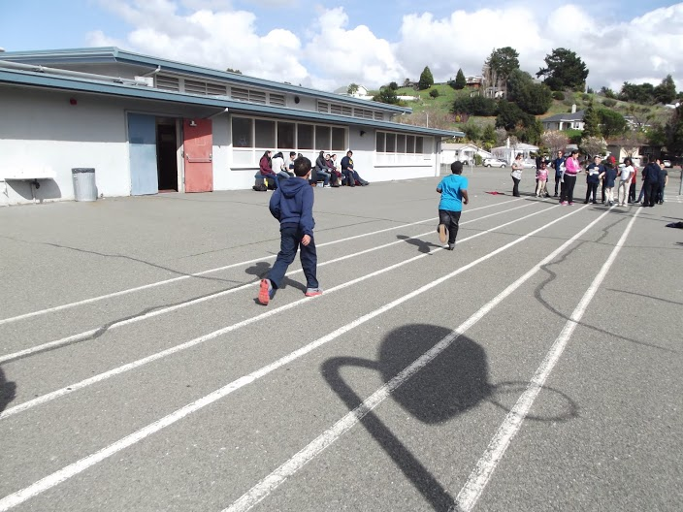
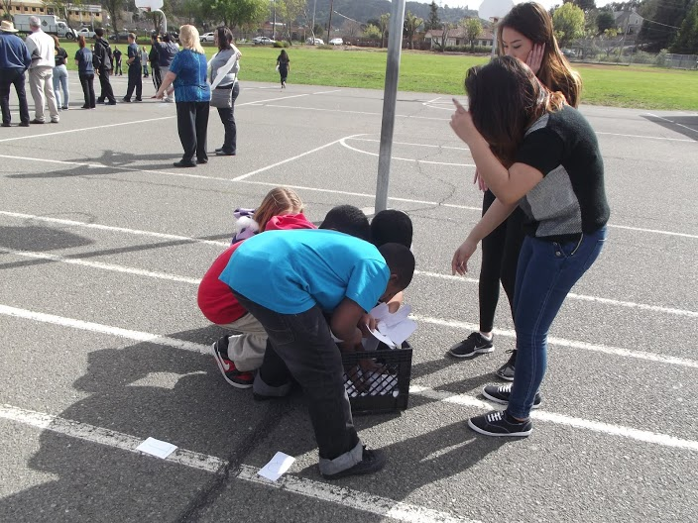

Slide 15
